Slide 1
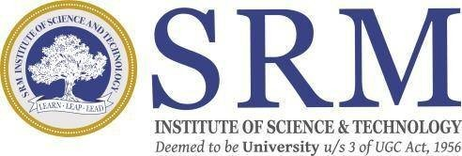
SRM INSTITUTE OF SCIENCE AND TECHNOLOGY SCHOOL OF COMPUTING
DEPARTMENT OF COMPUTER SCIENCE AND ENGINEERING
18CSP109L - MAJOR PROJECT
“AI NEXUS: A BLUEPRINT FOR MICROENTERPRISE BRILLIANCE”
Guide name: Ms. Nidhi Pandey
Designation: Assistant Professor
Department: CSE
Batch ID: 24MP2603099
Reg. No:RA2011026030099
Name: Lahari Krishnam
Reg. No:RA2011026030116
Name: Smaranika Udgata
Reg. No:RA2011026030117
Name: Avantika Gupta
Reg. No:RA2011026030119
Name: Suraj Singh

Slide 2
ABSTRACT
The project utilizes machine learning (ML) techniques alongside natural language processing (NLP) algorithms to analyze and comprehend user queries effectively.
Through the integration of a Language Model (LM) and a K-Nearest Neighbors (KNN) algorithm, the system provides personalized recommendations and solutions to address user problems, ensuring efficient problem-solving.
By offering precise problem resolution and valuable tool recommendations, the project aims to enhance the overall user experience, empowering users with effective and personalized solutions to their challenges.

Slide 3
INTRODUCTION
This Project exploring how Artificial Intelligence (AI) can transform microenterprises. By combining insights from business, economics, and technology, we're developing a practical framework tailored to the unique needs of microenterprises, addressing challenges and opportunities.
Our research considers not only the technological aspects but also delves into the socio-economic impact, including workforce dynamics and ethical considerations. The goal is to provide a practical guide for microenterprise owners, policymakers, and stakeholders interested in responsibly harnessing the benefits of AI for growth and innovation.

Slide 4
Existing Problems
The current system relies heavily on manual intervention, leading to inefficiencies in addressing user queries and adapting to their dynamic nature. This manual approach hampers the system's ability to provide timely and accurate responses to user needs.
challenge:
Reliance on manual intervention introduces inefficiencies.
Lack of sophisticated NLP algorithms and ML techniques hampers precision and personalization.
Inability to comprehend nuances in natural language communication.
Lack of ML-driven insights limits the system's capacity to learn and tailor responses.

Slide 5
Problem statement and Objectives
Microenterprises play a vital role in the economy, but they face challenges adapting to evolving technologies. While Artificial Intelligence (AI) offers transformative potential, integration poses difficulties. Existing literature lacks insight into how microenterprises, with industry-specific nuances and resource constraints, can strategically adopt and leverage AI for sustained success.
This Project aims to fill this gap, creating a tailored framework to unlock AI's potential for efficiency, innovation, and competitiveness in this critical sector.

Slide 6
Proposed Solution
Empowering users with tailored solutions that leverage vast knowledge bases and adapt to individual preferences.
Revolutionizing the user experience by seamlessly integrating advanced ML and NLP techniques for enhanced accuracy and effectiveness.
Offering a transformative approach to problem-solving, characterized by adaptability, efficiency, and user-centric design.
Ensuring scalability and flexibility to accommodate evolving user needs and technological advancements in ML and NLP fields.

Slide 7
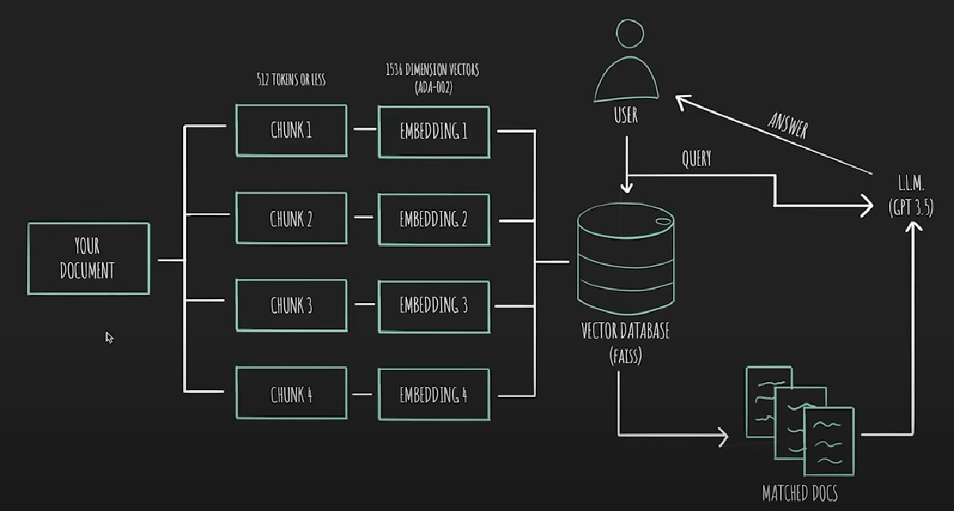
Architecture Diagram

Slide 8
Methodology
Problem Identification and Data Collection: Identify challenges and gather comprehensive data.
Preprocessing and Feature Extraction: Clean, transform data, and extract relevant features.
Machine Learning Model Development: Select, train, and optimize models for microenterprise solutions.
NLP Integration: Utilize advanced NLP algorithms for text analysis and understanding.
KNN Algorithm Integration: Incorporate KNN for personalized recommendation systems.
Ethical AI and Bias Mitigation: Establish frameworks and mitigate biases in AI algorithms.
Iterative Development and Refinement: Employ agile methodologies to facilitate continuous improvement.
Deployment and API Integration: Develop deployment strategies and APIs for model accessibility.
Documentation and Knowledge Sharing: Document processes and share insights for transparency and collaboration.

Slide 9
References
Radford, A., Narasimhan, K., Salimans, T., & Sutskever, I. (2018). "GPT (Generative Pre-Training) - Improving Language Understanding by Generative Pre-Training". OpenAI Blog. Retrieved from
Yang, Z., Dai, Z., Yang, Y., Carbonell, J., Salakhutdinov, R., & Le, Q. V. (2019). "XLNet: Generalized Autoregressive Pretraining for Language Understanding". arXiv preprint arXiv:1906.08237.
Dong, L., Yang, N., Wang, W., Wei, F., Liu, X., Wang, Y., ... & Gao, J. (2019). "UniLM: Unified Language Model Pre-training". arXiv preprint arXiv:1905.03197.

